Slide 1
CHIRURGIA DI PARETE NEL PAZIENTE AFFETTO DA OBESITÀ: PREVENZIONE E GESTIONE DELLE COMPLICANZE.
Fabio Cesare Campanile
Ospedale di civita castellana - VITERBO

Slide 2

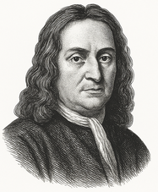
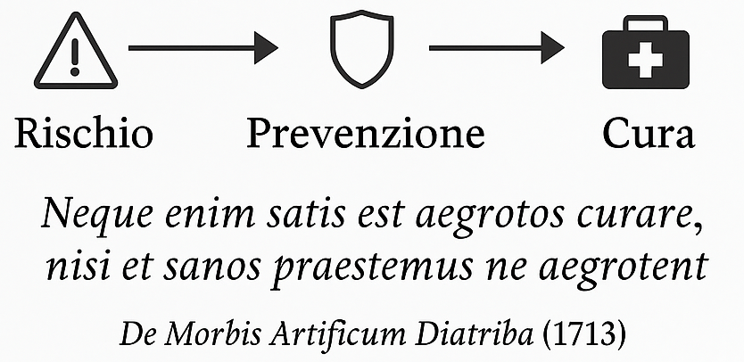

Slide 3

SCENARI DI RISCHIO IN CHIRURGIA DI PARETE
MECCANISMI:
↑Pressione addominale
↑Spessore del sottocutaneo
↓Perfusione e drenaggio linfatico
↑Tempo operatorio
ESITI (BMI ≥ 35):
Incidenza di SSO tripla¹
↑Deiscenza cutanea e liponecrosi¹
↑Rischio riammissione, reintervento e SSI²
1. Giordano SA, et al. The Impact of Body Mass Index on Abdominal Wall Reconstruction Outcomes: A Comparative Study. 2017;
2. Farhan SA, et al. Does BMI Impact Outcomes in Patients Undergoing Open Abdominal Wall Reconstruction? A Systematic Review and Meta-Analysis. 2025.

Slide 4

SCENARI DI RISCHIO IN CHIRURGIA DI PARETE
MECCANISMI:
↓Funzione immunitaria per ipoglicemia
↓Riparazione tissutale e ossigenazione tessuti per m. microvascolare
↓Funzione neutrofili
↑Stato infiammatorio catabolico
ESITI:
↑Incidenza di sieromi¹
↑SSO e SSI¹
↑Re-ospedalizzazioni²
1. Messer N. et al. The impact of diabetes and presurgical glycemic control on wound morbidity following open complex abdominal wall reconstruction: a single-center experience. Hernia 2024;
2. Romain B. et al.. Unplanned rehospitalizations after abdominal wall surgery: Update according to a review of the literature. J Visc Surg. 2025.

Slide 5

SCENARI DI RISCHIO IN CHIRURGIA DI PARETE
MECCANISMI:
↓Riserva fisiologica, mobilità e respirazione
↓Immunità e nutrizione
↓Deplezione proteica
ESITI:
↑Mortalità dopo AWR complessa¹
↑Recidiva¹
↑Ileo paralitico
↑Prolungata ospedalizzazione²
1. Clark ST et al. The emerging role of sarcopenia as a prognostic indicator in patients undergoing abdominal wall hernia repairs: a systematic review of the literature. Hernia. 2020;
2. Santana Valenciano Á et al. Role of sarcopenia in complex abdominal wall surgery: does it increase postoperative complications and mortality? Hernia. 2024.

Slide 6

SCENARI DI RISCHIO IN CHIRURGIA DI PARETE
MECCANISMI:
↓Trasporto di ossigeno
↓Vasocostrizione
↓Infiammazione respiratoria cronica e riduzione clearance mucociliare
ESITI:
↑SSI, SSO^{1,2}
↑Recidiva¹
↑Infezioni polmonari²
↑Nuovi ricoveri²
↑Mortalità²
1. da Silveira CAB et al. The impact of smoking on ventral and inguinal hernia repair: a systematic review and meta-analysis. Hernia. 2024;
2. DeLancey JO et al. The effect of smoking on 30-day outcomes in elective hernia repair. Am J Surg. 2018.

Slide 7
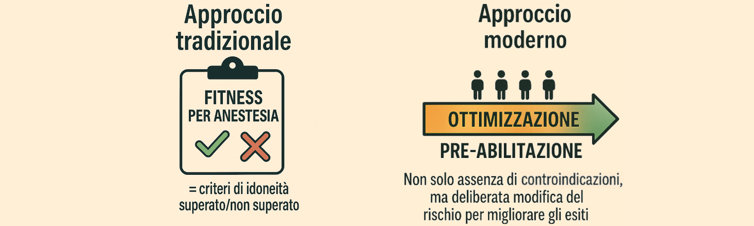
PREVENZIONE ATTRAVERSO L’OTTIMIZZAZIONE

Slide 8
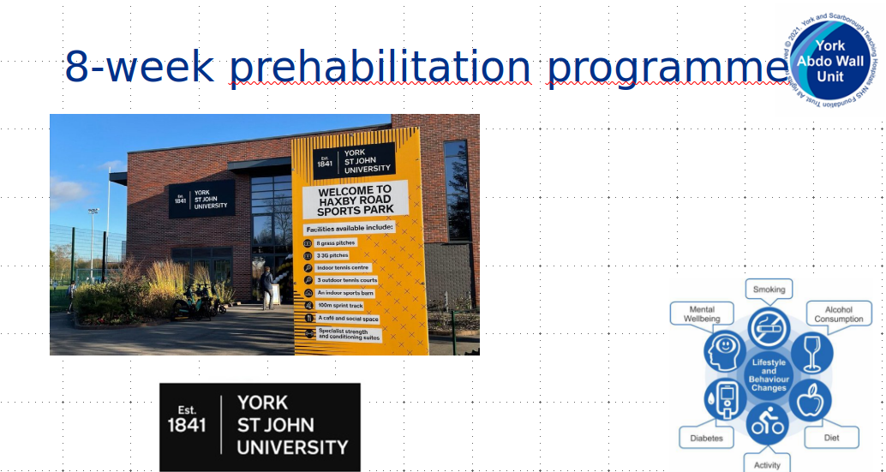
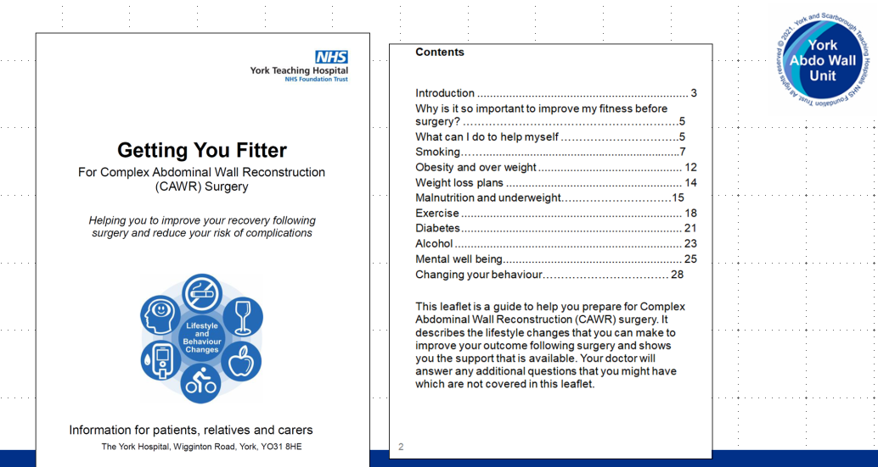
Courtesy of
Srinivas Chintapatla
York Abdo Wall, UK

Slide 9

DUE STRATEGIE

Slide 10
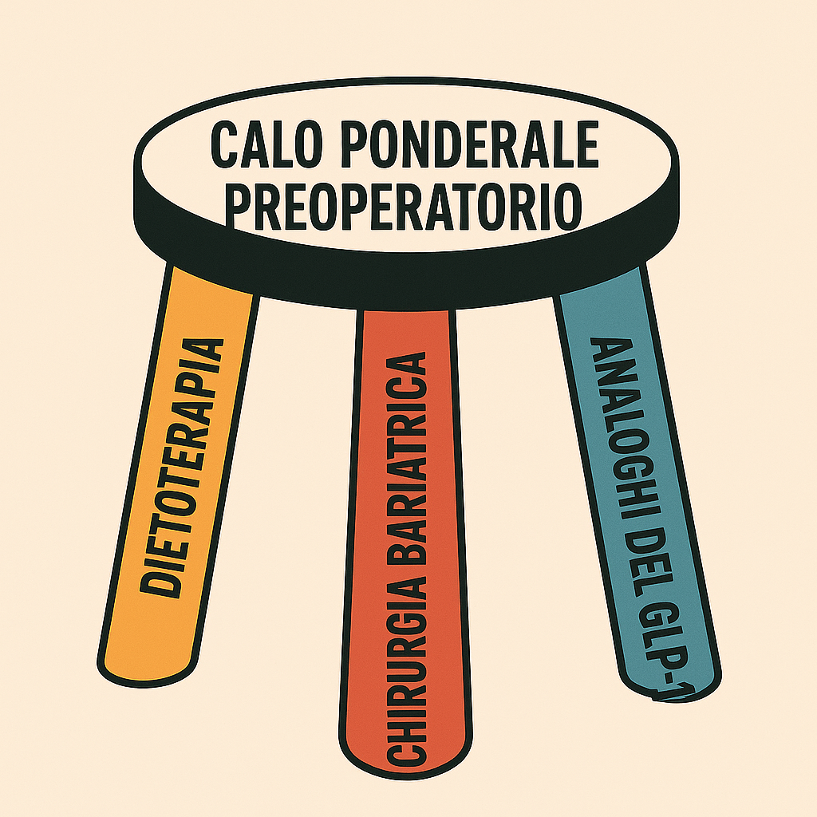

OTTIMIZZAZIONE DEL PAZIENTE

Slide 11
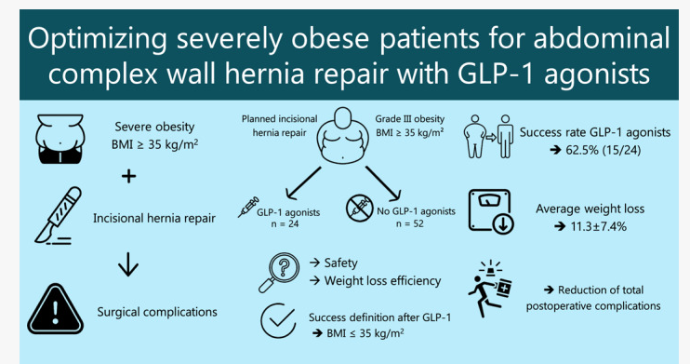
GLP-1 SEMAGLUTIDE
1. Romain B et al. Patients With Severe Obesity Are Made Eligible for Complex Abdominal Wall Repair After Preoptimization With GLP‐1 Agonists: Results of a Bicentric Pilot Study. World J Surg. 2025;
2. Spurzem GJ et al. GLP-1 receptor agonists are a transformative prehabilitation tool for weight loss in obese patients undergoing elective hernia repair. Surg Endosc. 2025;
3. Spurzem GJ et al. The new bridge to hernia surgery: achieving preoperative weight optimization with GLP-1 receptor agonists for abdominal wall hernia repair. Surg Endosc. 2025.

Slide 12

OTTIMIZZAZIONE DEL PAZIENTE
There is an increased risk of complications in patients with HbA1c > 6.5%, and elective repair should not be undertaken without individualized preoperative intervention. Grade B¹
_x005F_x000f_Avoid elective surgery on patients with HbA1c > 8.0%. Grade B¹
1. Liang MK et al. Ventral Hernia Management: Expert Consensus Guided by Systematic Review. Annals of Surgery. 2017;;

Slide 13

OTTIMIZZAZIONE DEL PAZIENTE
Assessment of malnutrition should be based upon clinical evaluation. Grade D¹
_x005F_x000f_Perioperative oral supplements, including arginine and fish oils,should be considered in high-risk patients undergoing gastrointestinal surgery. Grade A¹
1. Liang MK et al. Ventral Hernia Management: Expert Consensus Guided by Systematic Review. Annals of Surgery. 2017;;

Slide 14

OTTIMIZZAZIONE DEL PAZIENTE
Farmacoterapia e counseling ^{1,2}
L’astensione preoperatoria per 4 settimane dimezza le complicazioni (da 41% a 21%)³
1. Sørensen LT et al. Strategies of smoking cessation intervention before hernia surgery–effect on perioperative smoking behavior. Hernia 2007;
2. Iida H et al. A practical guide for perioperative smoking cessation. J Anesth 2022;
3. Lindström D et al. Effects of a perioperative smoking cessation intervention on postoperative complications: a randomized trial. Ann Surg 2008.

Slide 15
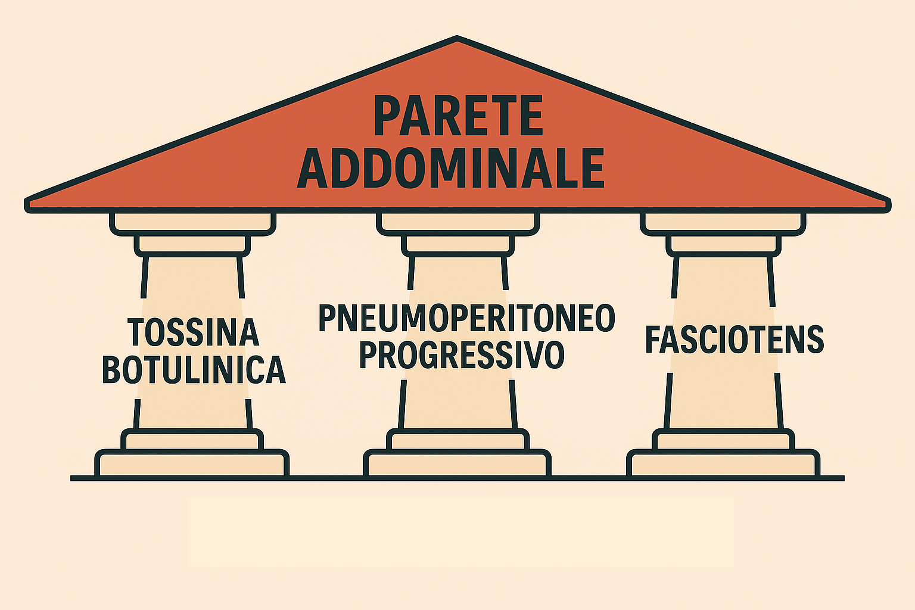
OTTIMIZZAZIONE DELLA PARETE ADDOMINALE

Slide 16
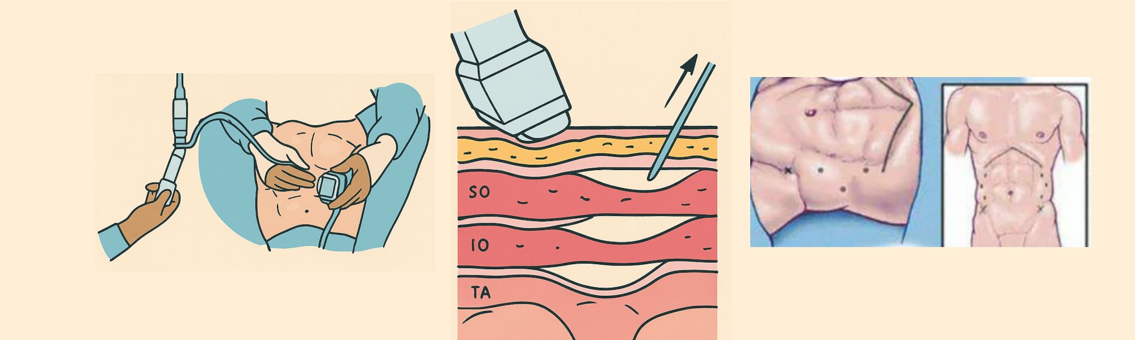
TOSSINA BOTULINICA
1. Deerenberg EB et al. The Effects of Preoperative Botulinum Toxin A Injection on Abdominal Wall Reconstruction. J Surg Res. 2021;
2. Amaral PHF et al. Volumetry after botulinum toxin A: the impact on abdominal wall compliance and endotracheal pressure. Hernia. 2024;
3. Barretto VRD et al. Botulinum toxin A in complex incisional hernia repair: a systematic review. Hernia. 2024.

Slide 17
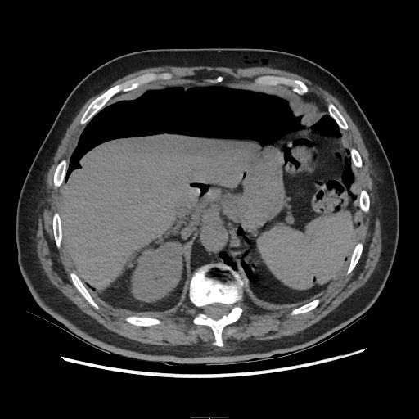
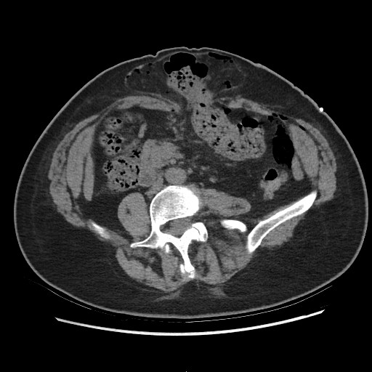
PNEUMOPERITONEO PROGRESSIVO

Slide 18
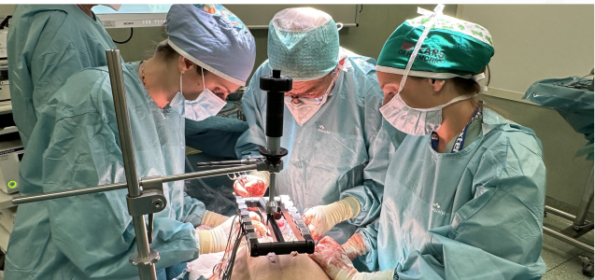
FASCIOTENS

Slide 19
Grazie

